Slide 1
Algorithms and Complexity
Intro to Algorithm Analysis
Neil Patrick Del GALLEGO

Slide 2
Posteriori Estimate
Input Size | 10 | 100
Algo 1 | 1 sec | 10 sec
Algo 2 | 3 sec | 15 sec
Algo 1 seems to be more efficient than Algo 2

Slide 3
Posteriori Estimate
Input Size | 10 | 100 | 1000
Algo 1 | 1 sec | 10 sec | 100 sec
Algo 2 | 3 sec | 15 sec | 30 sec
Is Algo 1 faster then Algo 2?

Slide 4
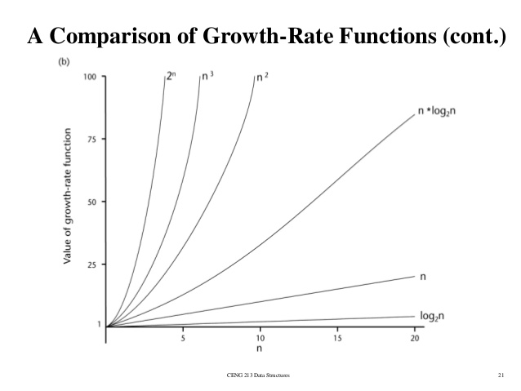
Growth of Functions

Slide 5
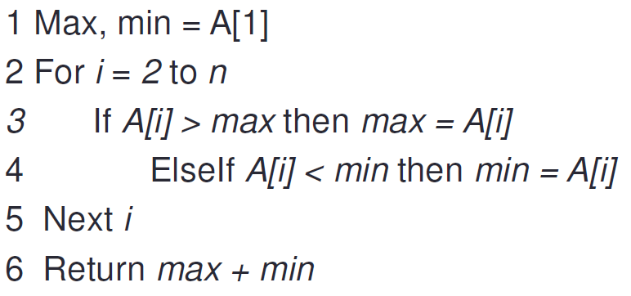
Apriori Estimate
Simply reading the code and estimating running time. Assume that each line of code takes c time units.

Slide 6
Apriori Estimate
c
(n – 1) * c
c
Simply reading the code and estimating running time. Assume that each line of code takes c time units.

Slide 7
Frequency Counting

Slide 8
Asymptotic Bounds - Big-Oh, Theta, and Omega
Asymptotic Bounds are used instead to describe the complexity of the algorithms
Asymptotic Bounds describes only the growth rates of the algorithm as the input size approaches infinity and ignoring most of the small inputs and constant factors [1]
Among these bounds are: Big-Oh, Big-Omega and Theta

Slide 9
Big-Oh notation
The Big-Oh of a function g(n) is O( f(n) ), iff there exist a positive number c and n0 such that:
0 <= g(n) <= c f(n) where n > n0
Describes an asymptotically loose upper bound of the algorithm
Represents the worst-case running time of the algorithm

Slide 10
Big-Omega notation
The Big-Omega of a function g(n) is Ω( f(n) ), iff there exist a positive number c and n0 such that:
0 <= c f(n) <= g(n) where n > n0
Describes an asymptotically loose lower bound of the algorithm
Represents the best-case running time of the algorithm

Slide 11
Big-Theta notation
The Theta of a function g(n) is θ( f(n) ), iff there exist a positive number c, c’ and n₀ such that:
c₁ f(n) <= g(n) <= c₂ f(n) where n > n₀
Describes an asymptotically tight bound of the algorithm
Represents the average-case running time of the algorithm*

Slide 12
Summary
Big Oh is the upper bound of f(n)
Big Omega is the lower bound of f(n)
Big Theta requires Big Oh and Big Omega values such that it is “sandwiched” between them.

Slide 13
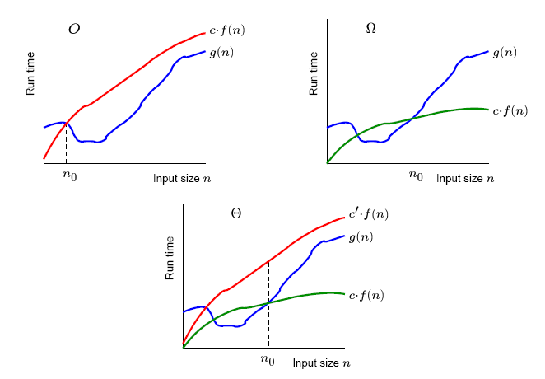
Asymptotic Bounds

Slide 14
Explanation
An algorithm that is stated to perform Omega(n log n) guarantees that it performs AT LEAST n log n time. However, the upper bound is not known (worst case).
An algorithm that is stated to perform O(n^2) guarantees that it performs AT MOST n^2 time. However, the lower bound is not known (best case). There exists algorithms that state that it performs O(n^2). However, on some cases, it may run faster than the specified amount.

Slide 15
Explanation
Big Theta is guaranteed that an algorithm is bounded. If an algorithm states that it runs Theta(n log n), therefore it means that it can perform at least n log n time but not more than n log n. Hence, asymptotically tight.

Slide 16
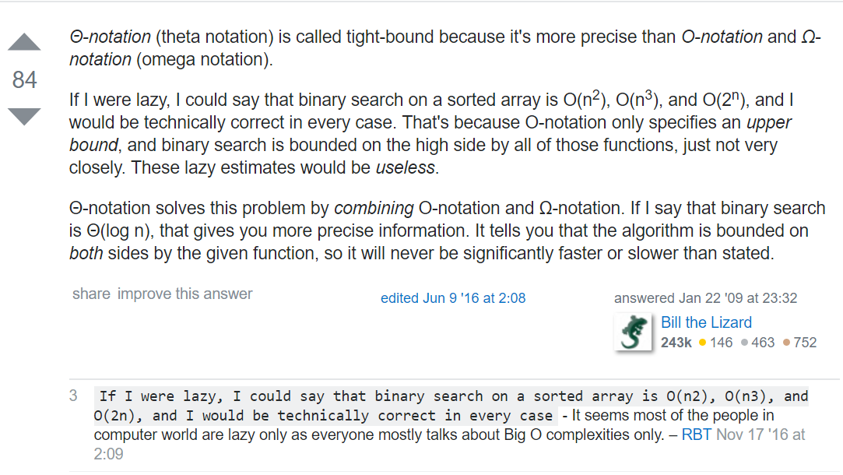
Explanation

Slide 17
Growth of Functions
 | 1 | 5 | 10 | 11
(log n) +1 | 1 | 1.7 | 2 | 2.04
n | 1 | 5 | 10 | 11
3n-1 | 2 | 14 | 29 | 32
n² | 1 | 25 | 100 | 121
10n² | 10 | 250 | 1000 | 1210
2^{n} | 2 | 32 | 1024 | 2048

Slide 18
Growth of Functions

Slide 19
Common Upper Bounds
O(1) constant
O(log n) logarithm
O(n) linear
O(n log n) linear log
O(n²) quadratic
O(n³) cubic
O(2^{n}) exponential

Slide 20
Observations on Growth
The dominant term (term with the fastest growth rate) in the function determines the behavior of the algorithm
Any exponential function of n dominates any polynomial function of n
A polynomial degree k dominates a polynomial of degree m iff k > m
Any polynomial function of n dominates any logarithmic function of n
Any logarithmic function of n dominates a constant term

Slide 21
End of Slides

